Slide 1
The human heart
Anatomy

Slide 3
Lesson Objective
Prepare for Heart Dissection Assessment.

Slide 4
Lesson Content
Discuss Assessment.
Watch Videos and discuss Dissection
Review Heart

Slide 5
Assessment

Slide 6
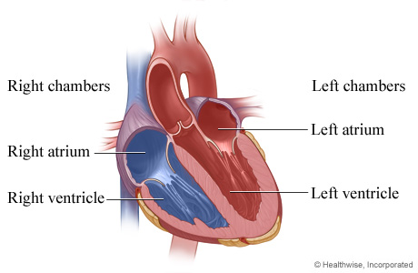
The heart structure
The heart contains 4 chambers:

Slide 7
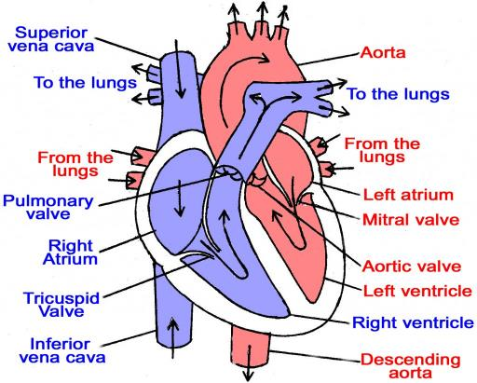
The human heart

Slide 8
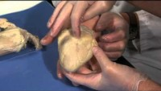
Dissection Part 1

Slide 9
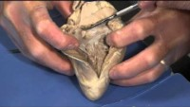
Dissection Part 2

Slide 10
Heart structure
The atria act as receiving chambers for blood.
The ventricles pump blood away from the heart.

Slide 11
Heart chambers
The chambers on the right side of the heart are smaller and have less muscle in their heart wall when compared to the left side of the heart.
The right side of the heart maintains pulmonary circulation to the nearby lungs .
The left side of the heart pumps blood all the way to the extremities of the body in the systemic circulatory loop.

Slide 12
Valves of the heart
To prevent blood from flowing backwards or “regurgitating” back into the heart, a system of one-way valves are present in the heart.

Slide 13
Two types of valves in the heart
Atrio-ventricular valves (mitral, tricuspid). The atrio-ventricular (AV) valves between the atria and ventricles and only allow blood to flow from the atria into the ventricles.
Semi-lunar valves. The semi-lunar valves, are located between the ventricles and the arteries that carry blood away from the heart.

Slide 14
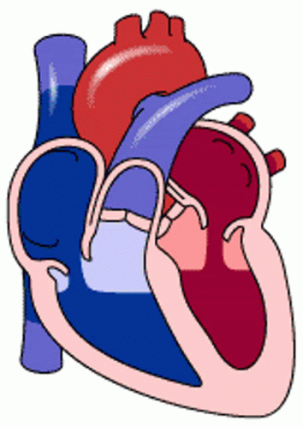
Blood flow through the heart

Slide 15
Blood flow (right side)
Deoxygenated blood returning from the body first enters the heart from the superior and inferior vena cava.
The blood enters the right atrium and is pumped through the atrio-ventricular (tricuspid) valve into the right ventricle.
From the right ventricle, the blood is pumped through the pulmonary semilunar valve into the pulmonary artery to the lungs.

Slide 16
Blood flow (left side)
Oxygen rich blood in the lungs returns to the heart through the pulmonary veins.
Blood enters the heart again in the left atrium.
Blood is pumped through the bicuspid (mitral) valve into the left ventricle.
The left ventricle pumps blood through the aortic semilunar valve into the aorta to the body.

Slide 17
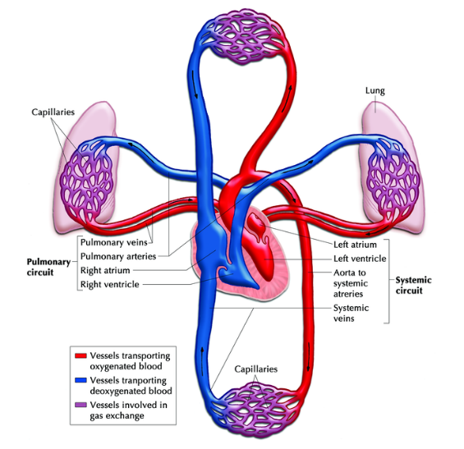
Pulmonary and systemic circulation

